Slide 1
Express
Lecturer: Ngo Huy Bien
Software Engineering Department
Faculty of Information Technology
University of Science
Ho Chi Minh City, Vietnam
nhbien@fit.hcmus.edu.vn

Slide 2

Objectives
To create a web application using Express

Slide 3

Contents

Slide 4

References
Jonathan Wexler (2019). Get Programming with Node.js. Manning Publications.
Bruno Joseph D'mello et al. (2017). Web Development with MongoDB and Node.

Slide 5
What is Express? [1]
Express increases development speed and provides a stable structure on which to build applications.
Ultimately, a framework is intended to help you overcome some common development challenges in building a web application from scratch.
A web framework is designed to offer some of the common tools used in web development.
Express provides methods and modules to assist with
handling requests,
serving static and dynamic content,
connecting databases, and
keeping track of user activity, for example.

Slide 6
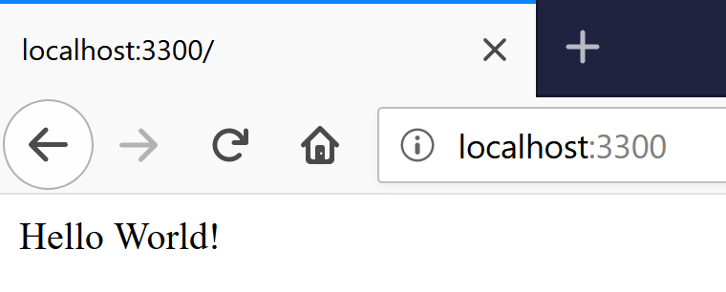
1. Create an Express Application
npm init
npm install express –save
node index.js
const port = 3000,
express = require("express"),
app = express();
app.get("/", (req, res) => {
res.send("Hello World!");
})
.listen(port, () => {
console.log(`The Express server has started and is listening on port number: ${port}`);
});

Slide 7
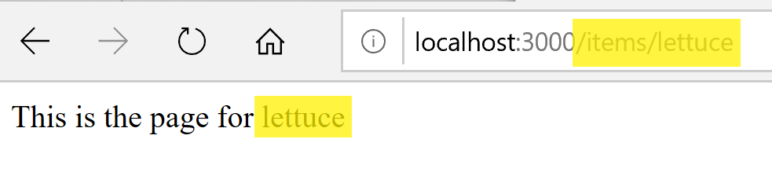
2. Build Routes with Express
Express is a type of middleware because it adds a layer between a request being received and that request being processed.
const port = 3000,
express = require("express"),
app = express();
app.get("/items/:vegetable", (req, res) => {
let veg = req.params.vegetable;
res.send(`This is the page for ${veg}`);
});
app.listen(port, () => {
console.log(`Server running on port: ${port}`);
});

Slide 8
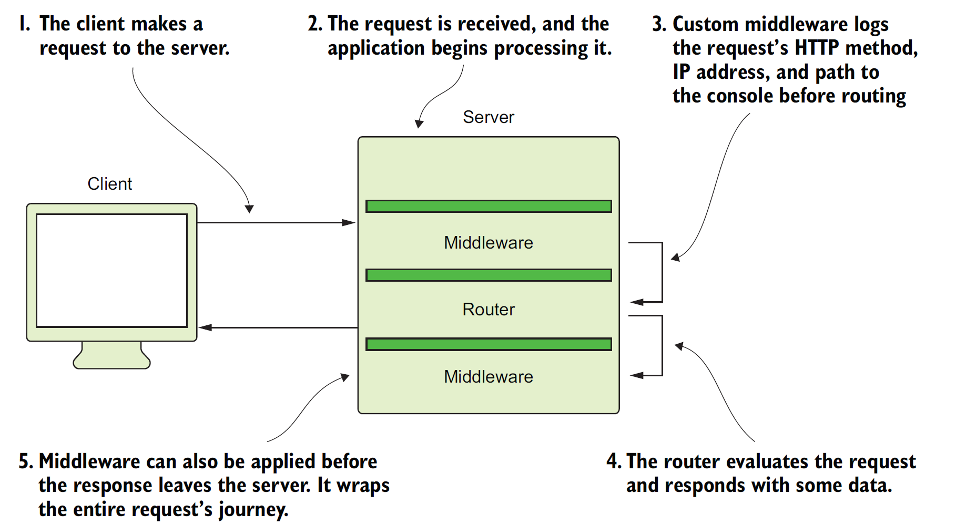
Middleware Functions

Slide 9
Middleware [2]
Middleware: A filter that every request to your server passes through.
Every request passes through each filter and each filter can perform a specific task against the request before it passes through to the next filter.
These filters are used for tasks such as cookie parsing, form-field handling, session handling, authentication, and error handling and logging.
Request
Middleware 1
Middleware 2
...
Request handler
Middleware N

Slide 10
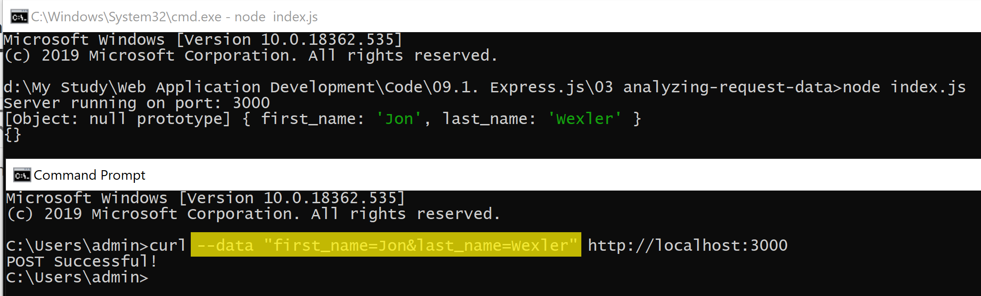
3. Handle POST Request Data [1]
// Tell your Express application to parse URL-encoded data.
app.use(
express.urlencoded({
extended: false
})
);
app.use(express.json());
// Create a new post route for the home page.
app.post("/", (req, res) => {
// Log the POST request’s body.
console.log(req.body);
console.log(req.query);
res.send("POST Successful!");
});

Slide 11
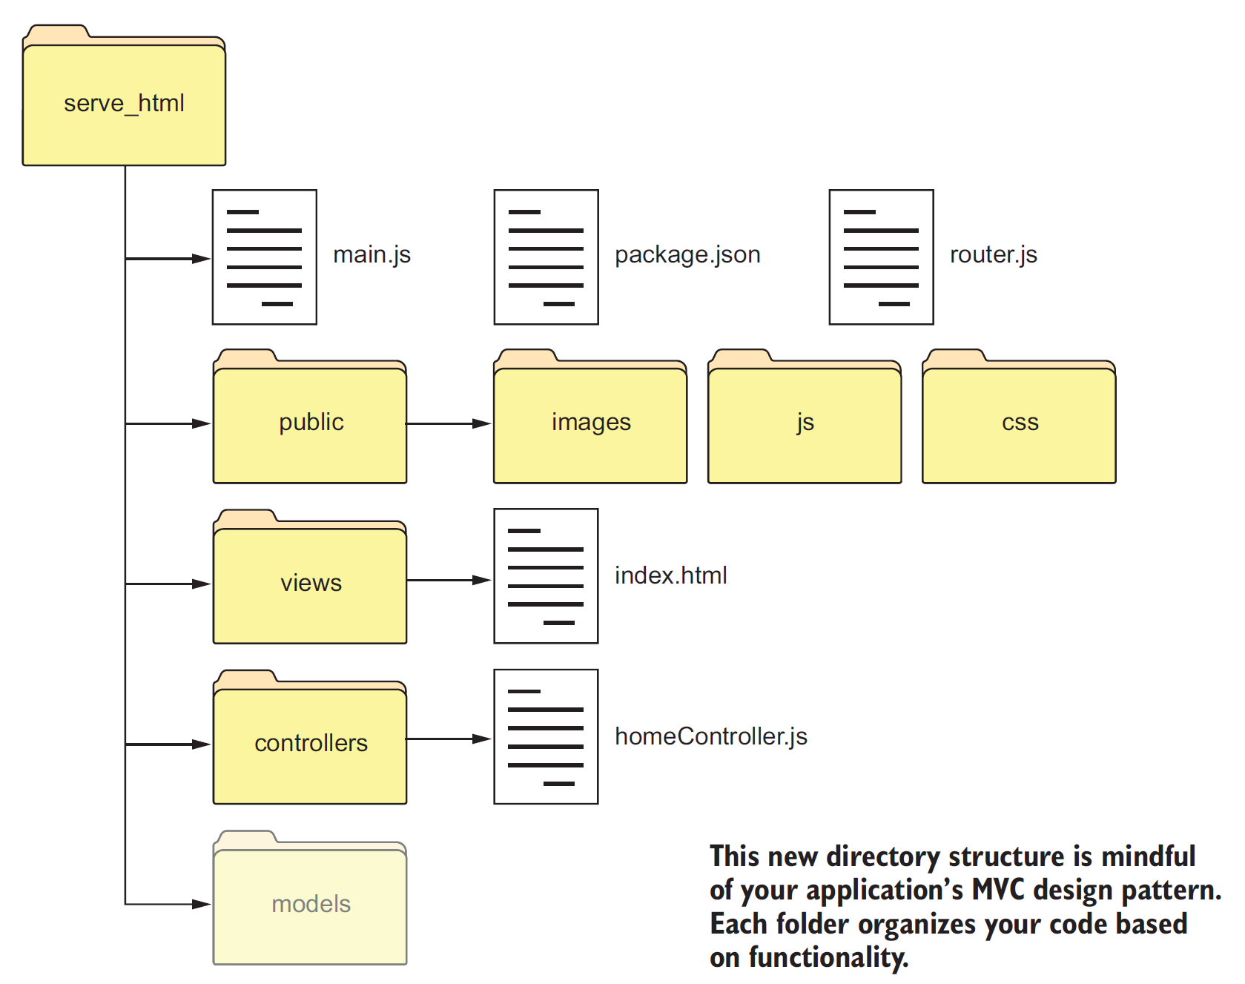
Express MVC File Structure

Slide 12
4. Create Folder Structure
/(project root)
---/helpers
---/controllers
---/public
------/css
------/img
------/js
------/upload
---/server
---/views
------/layouts
------/partials

Slide 13
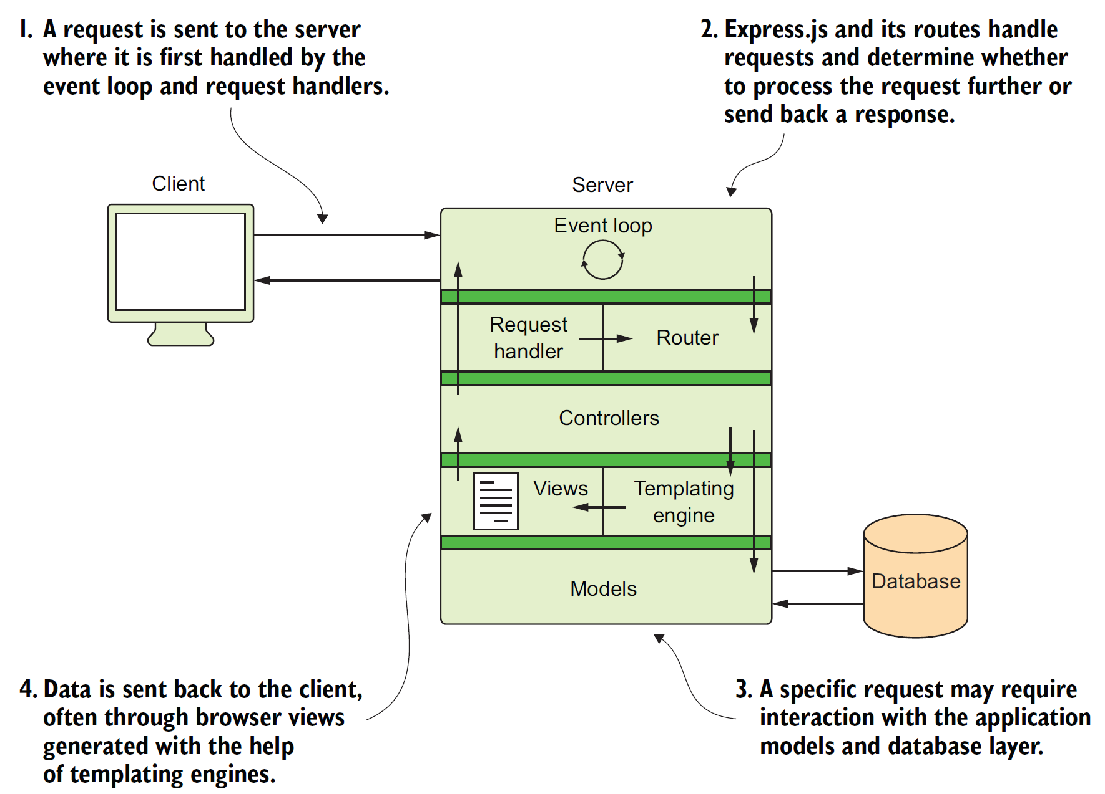
How to Use MVC

Slide 14
5. Handle Requests using Controller
// Create a function to handle route-specific requests.
exports.sendReqParam = (req, res) => {
let veg = req.params.vegetable;
res.send(`This is the page for ${veg}`);
};
const homeController = require("./controllers/homeController");
const port = 3000,
express = require("express"),
app = express();
// Handle GET requests to "/items/:vegetable".
app.get("/items/:vegetable", homeController.sendReqParam);
app.listen(port, () => {
console.log(`Server running on port: ${port}`);
});

Slide 15
What is Templating Engine?
Templating allows you to code your views with the ability to insert dynamic data.
A templating engine is what Express uses to process your views and convert them to browser-readable HTML pages.
Any non-HTML lines are converted to HTML, with values rendered where embedded variables once were.
There are many templating languages like EJS, but this book assumes that you have moderate experience with HTML, and EJS proves to be the most effective and simplest templating language to learn.

Slide 16
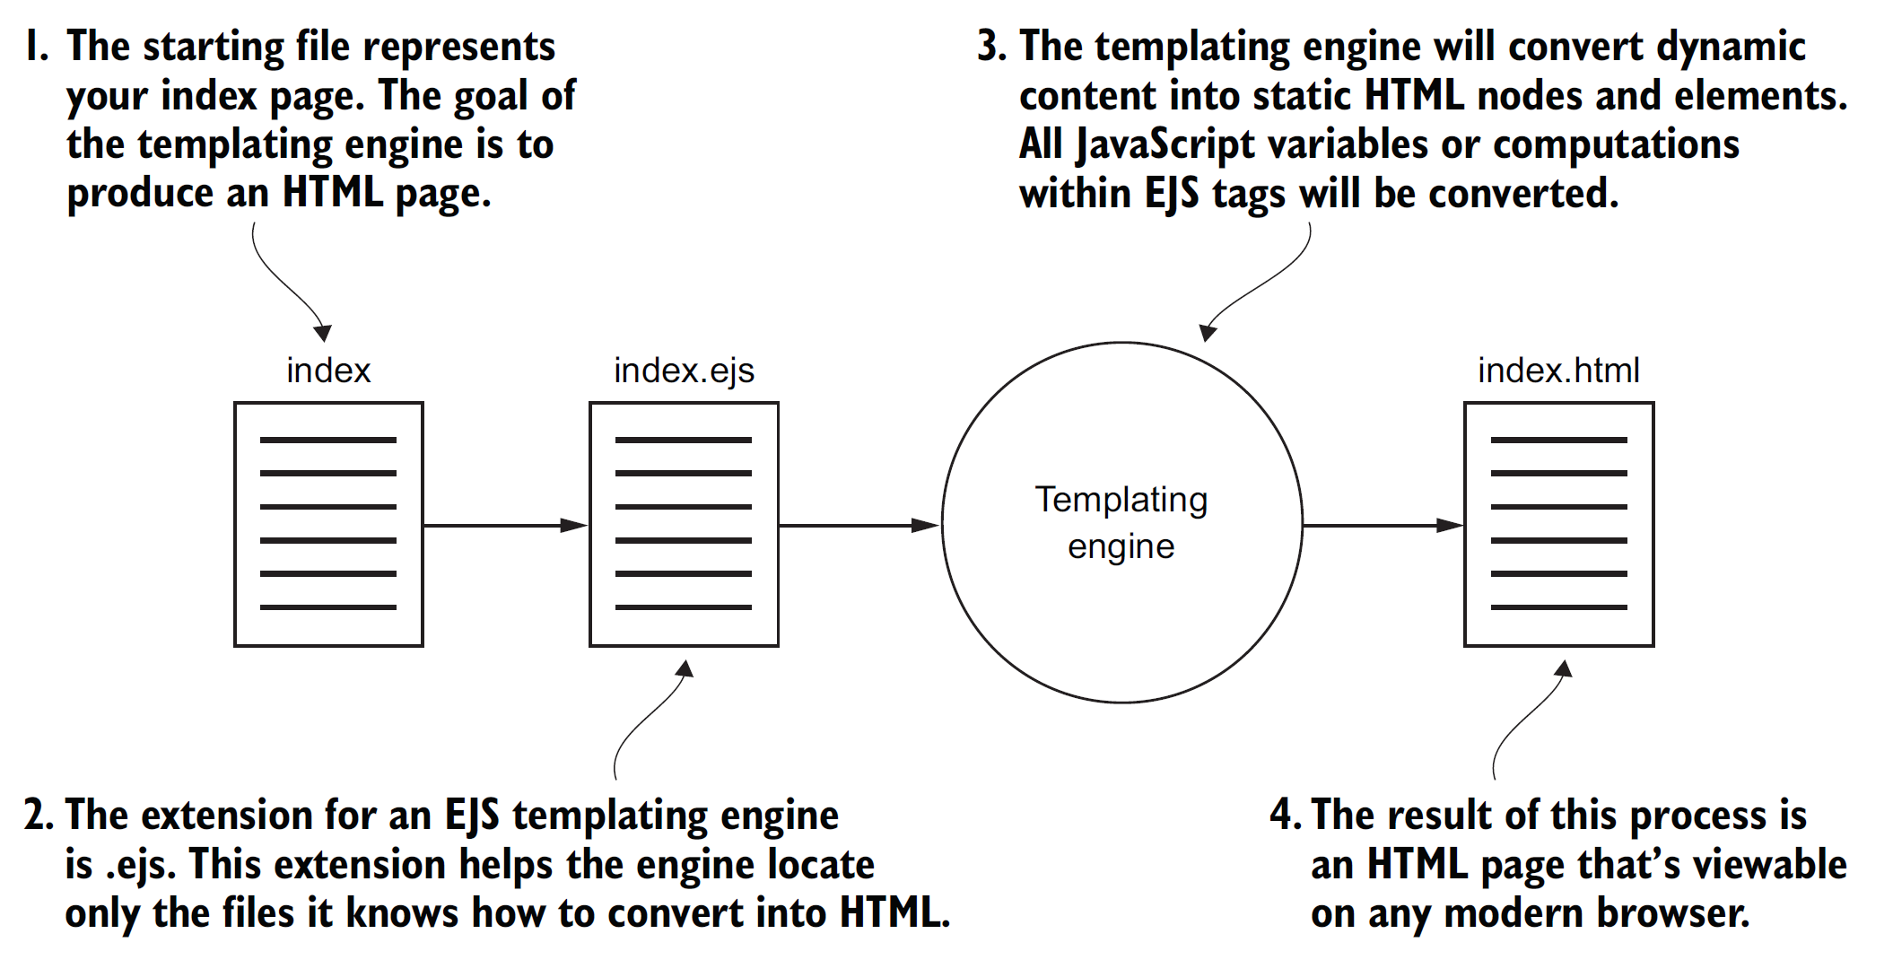
Converting EJS to HTML

Slide 17
6. Configure express to Use EJS
npm install ejs --save
const homeController = require("./controllers/homeController");
const port = 3000,
express = require("express"),
app = express();
app.set("view engine", "ejs");
app.get("/name", homeController.respondWithName);
app.get("/name/:myName", homeController.respondWithName2);
app.listen(port, () => {
console.log(`Server running on port: ${port}`);
});

Slide 18
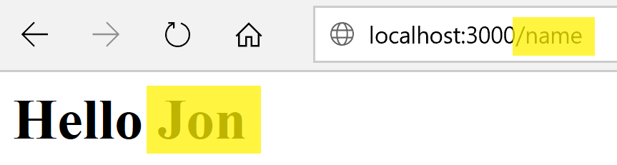
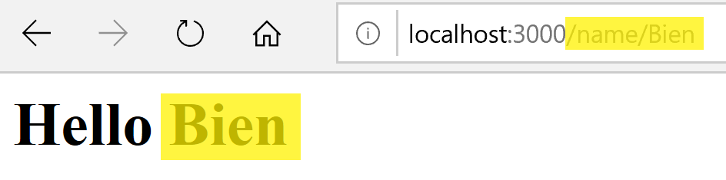
7. Generate Views using EJS
// Respond with a custom EJS view.
exports.respondWithName = (req, res) => {
res.render("index");
};
exports.respondWithName2 = (req, res) => {
// Assign a local variable to a request parameter.
let paramsName = req.params.myName;
// Pass a local parameter to a rendered view.
res.render("index2", { name: paramsName });
};
<% let name = "Jon"; %>
<h1> Hello <%= name %> </h1>
<h1> Hello <%= name %> </h1>

Slide 19


Slide 20
Application's Entry Point (server.js) [2]
const express = require('express');
// config = require('./server/configure');
let app = express();
// app = config(app);
app.set('port', process.env.PORT || 3300);
app.set('Views', '${__dirname}/Views');
app.get('/', (req, res) => {
res.send('Hello World!');
});
app.listen(app.get('port'), () => {
console.log(`Server up: http://localhost:${app.get('port')}`);
});

Slide 21
server/configure.js
const path = require('path'),
//routes = require('./routes'),
exphbs = require('express-handlebars'), // templating (view) engine
express = require('express'),
bodyParser = require('body-parser'), //form fields
cookieParser = require('cookie-parser'),
morgan = require('morgan'), // logging
methodOverride = require('method-override'), // REST support for older browsers
errorHandler = require('errorhandler');
module.exports = (app) => {
app.use(morgan('dev'));
app.use(bodyParser.urlencoded({'extended':true}));
app.use(bodyParser.json());
app.use(methodOverride());
app.use(cookieParser('some-secret-value-here'));
// routes(app);//moving the routes to routes folder.
app.use('/public/', express.static(path.join(__dirname,
'../public'))); // serving static content
if ('development' === app.get('env')) {
app.use(errorHandler());
}
return app;
};

Slide 22
Activate The Configure Module
const express = require('express');
config = require('./server/configure');
let app = express();
app = config(app);

Slide 23
server/routes.js
const express = require('express'),
router = express.Router(),
home = require('../controllers/home'),
image = require('../controllers/image');
module.exports = (app)=>{
router.get('/', home.index);
router.get('/images/:image_id', image.index);
router.post('/images', image.create);
router.post('/images/:image_id/like', image.like);
router.post('/images/:image_id/comment', image.comment);
app.use(router);
};

Slide 24
controllers/home.js
module.exports = {
index(req, res) {
res.send('The home:index controller');
}
};

Slide 25
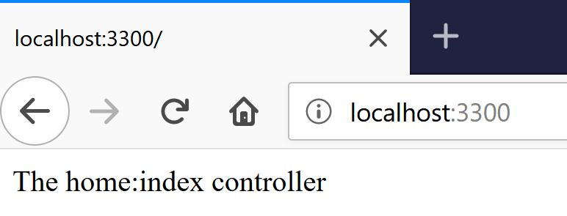
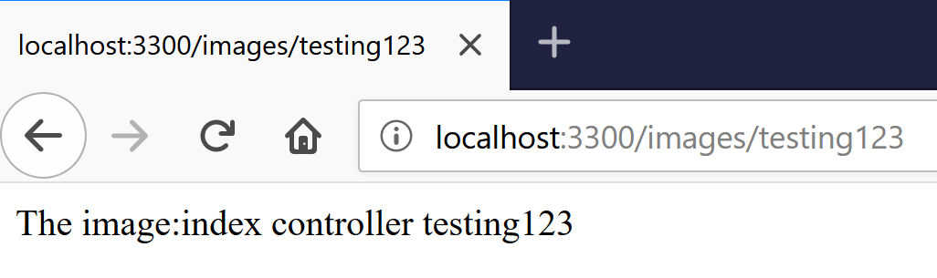
controllers/image.js
module.exports = {
index(req, res) {
res.send(`The image:index controller ${req.params.image_id}`);
},
create(req, res) {
res.send('The image:create POST controller');
},
like (req, res) {
res.send('The image:like POST controller');
},
comment(req, res) {
res.send('The image:comment POST controller');
}
};

Slide 26
server/configure.js
// ATTENTION: CASE-SENSITIVE
...
if ('development' === app.get('env')) {
app.use(errorHandler());
}
app.engine('handlebars', exphbs.create({
defaultLayout: 'main',
layoutsDir: `${app.get(‘views')}/layouts`,
partialsDir: [`${app.get(‘views')}/partials`]
}).engine);
app.set(‘view engine', 'handlebars');
return app;
};

Slide 27
views/index.handlebars
<div class="panel panel-primary">
<div class="panel-heading">
<h3 class="panel-title">
Upload an Image
</h3>
</div>
<form method="post" action="/images" enctype="multipart/form-data">
<div class="panel-body form-horizontal">
...
<div class="panel-body">
{{#each images}}
<div class="col-md-4 text-center" style="padding-bottom:
1em;">
<a href="/images/{{ uniqueId }}">
<img src="/public/upload/{{filename}}" alt="{{title}}"
style="width: 175px; height: 175px;" class="img-
thumbnail">
</a>
</div>
{{/each}}
</div>

Slide 28
views/layouts/main.handlebars
<div class="container">
<div class="row">
<div class="col-sm-8">
{{{ body }}}
</div>
<div class="col-sm-4">
{{> stats this }}
{{> popular this }}
{{> comments this }}
</div>
</div>
</div>

Slide 29
views/partials/stats.handlebars
<div class="row">
<div class="col-md-2 text-left">Images:</div>
<div class="col-md-10 text-right">
{{ sidebar.stats.images }}
</div>
</div>
<div class="row">
<div class="col-md-2 text-left">Comments:</div>
<div class="col-md-10 text-right">
{{ sidebar.stats.comments }}
</div>
</div>
<div class="row">
<div class="col-md-2 text-left">Views:</div>
<div class="col-md-10 text-right">
{{ sidebar.stats.views }}
</div>
</div>

Slide 30
Render a View
We are calling res.render and passing in the name of the template file we want to render as the only parameter (for now).
Using the defaults that were defined in our configure module, the index file will be loaded from our views folder.
controllers/home.js
module.exports = {
index(req, res) {
res.render('index');
}
};

Slide 31
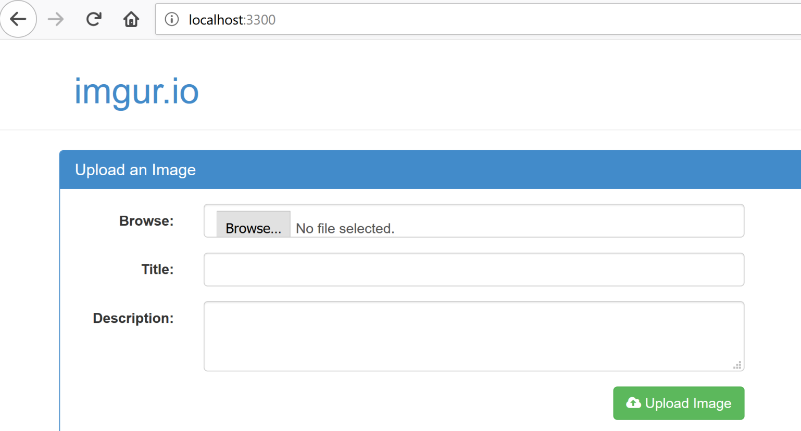
Start the Server
$ npm start

Slide 32
Helpers (server/configure.js)
// ATTENTION: CASE-SENSITIVE
...
errorHandler = require('errorhandler'),
moment = require('moment');
...
app.engine('handlebars', exphbs.create({
defaultLayout: 'main',
layoutsDir: `${app.get('views')}/layouts`,
partialsDir: [`${app.get('views')}/partials`],
helpers: {
timeago: (timestamp)=> {
return moment(timestamp).startOf('minute').fromNow();
}
}
}).engine);
app.set('view engine', 'handlebars');
return app;
};
$ npm install moment --save

Slide 33
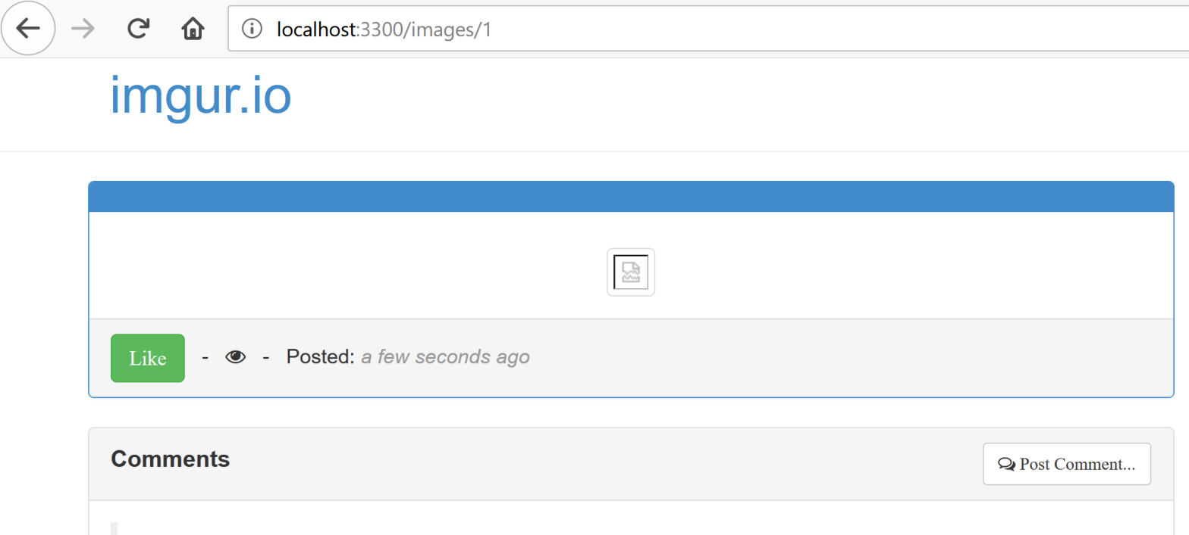
views/image.handlebars

Slide 35
Controllers
A controller can be defined as an entity that will be responsible for manipulating models and initiating the View render process with the data received from the corresponding models.
The express router instance is used to tie functions to a corresponding route. These functions are inside controllers.
For every route that we create in our router, the following two parameters are necessary:
the string for the route itself, which is /images/:image_id
a controller function that will be executed when that route is accessed

Slide 36
View Models
The term View model is used here to refer to the data form of the model, which will be tied to the template while rendering the HTML via any templating framework.
A View model is typically just a single JavaScript object that can be passed to the template.
The View model for a page will typically contain all of the data necessary to render the content-specific portions of that page.
It is the task of the templating engine to produce the corresponding HTML by processing the templates with the associated models.

Slide 37
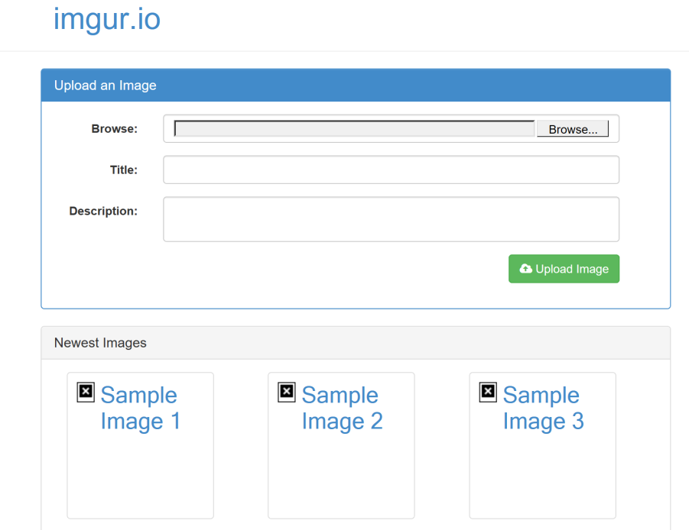
controllers/home.js
module.exports = {
index(req, res) {
const ViewModel = {
images: [{
uniqueId: 1,
title: 'Sample Image 1',
description: '',
filename: 'sample1.jpg',
Views: 0,
likes: 0,
timestamp: Date.now()
}, {
uniqueId: 2,
title: 'Sample Image 2',
description: '',
filename: 'sample2.jpg',
Views: 0,
likes: 0,
timestamp: Date.now()
},
...
res.render('index', ViewModel);
}
};

Slide 38
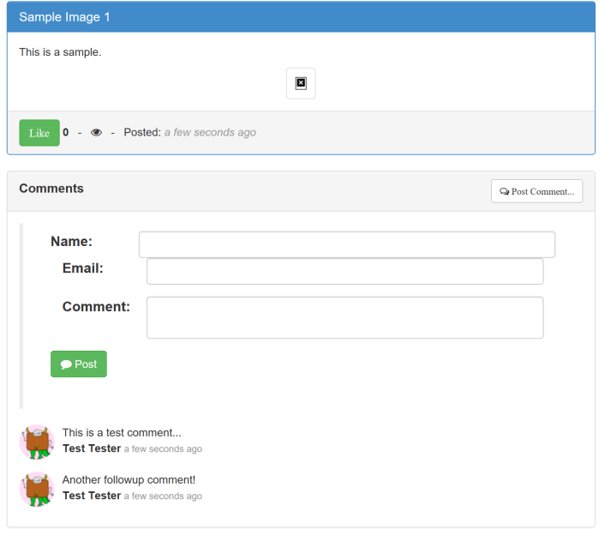
controllers/image.js
module.exports = {
index: (req, res) => {
const ViewModel = {
image: {
uniqueId: 1,
title: 'Sample Image 1',
description: 'This is a sample.',
filename: 'sample1.jpg',
Views: 0,
likes: 0,
timestamp: Date.now()
},
comments: [{
image_id: 1,
email: 'test@testing.com',
name: 'Test Tester',
gravatar: 'http://lorempixel.com/75/75/animals/1',
comment: 'This is a test comment...',
timestamp: Date.now()
},
...
};
res.render('image', ViewModel);
},
...
comment(req, res) {
res.send('The image:comment POST controller');
}
};

Slide 39
Add File Uploads (multer)
$ npm install multer --save
//server/routes.js
...
image = require('../controllers/image'),
multer = require('multer'); // file uploads
...
router.post('/images/:image_id/comment', image.comment);
app.use(router);
const upload = multer({ dest: 'public/upload/temp' }); // file uploads configuration
app.post('/images', upload.single('file'), image.create);
};

Slide 41
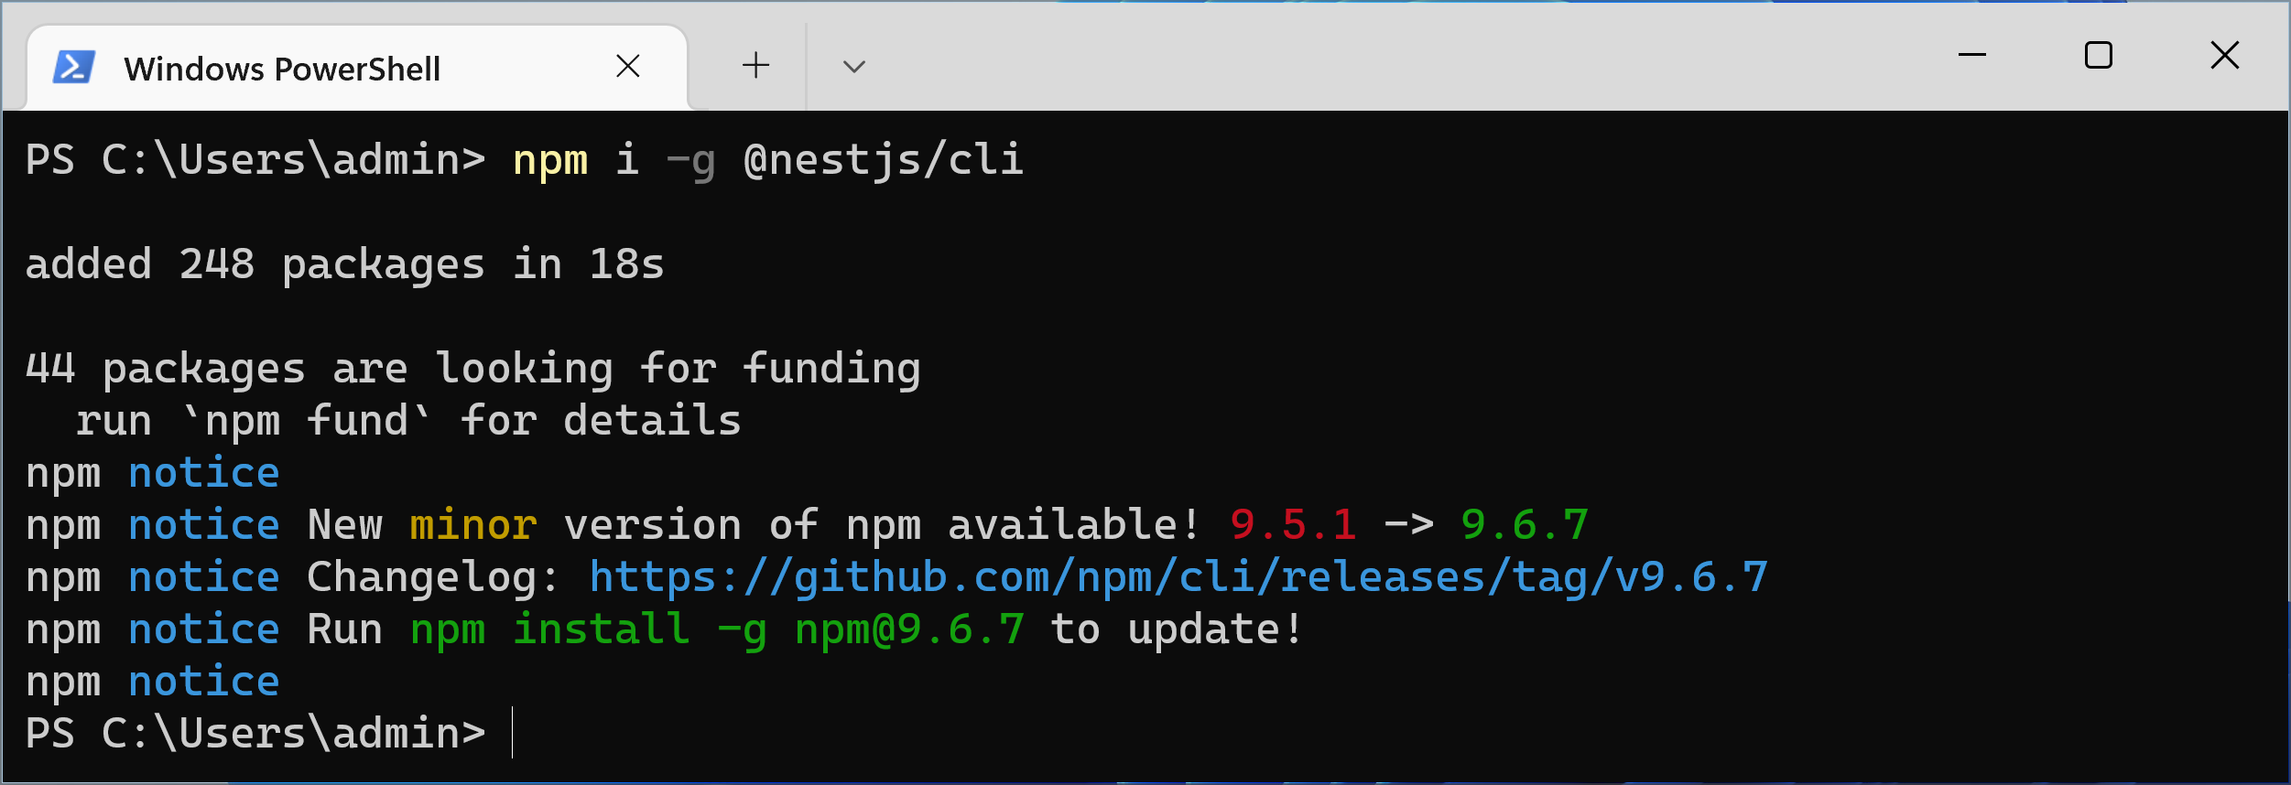
1. Install NestJs
npm i -g @nestjs/cli

Slide 42

Thank You & See You Again

